Slide 1
Progress report
Speaker: Geng-Yun Tien
Advisor: Eric Y. Chuang
Date: 2023/09/22

Slide 2
Works
1
SimCLR: A Simple Framework for Contrastive Learning of Visual Representations
Other works
1
TA works & homework

Slide 3
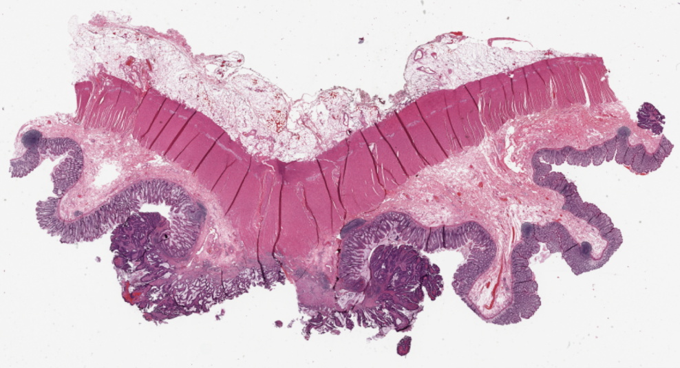
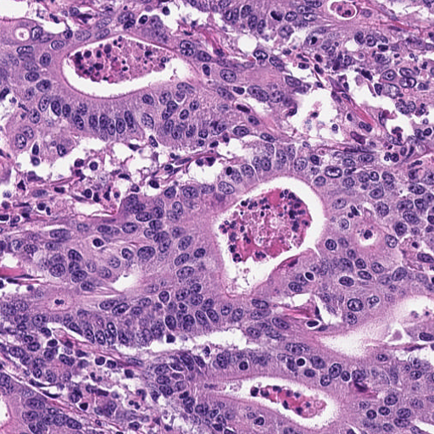
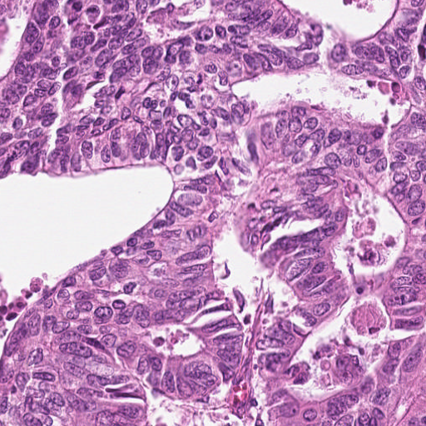
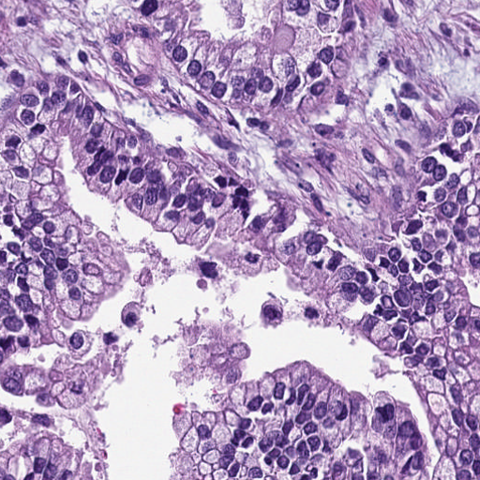
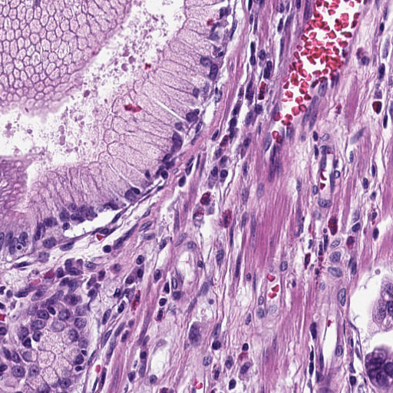
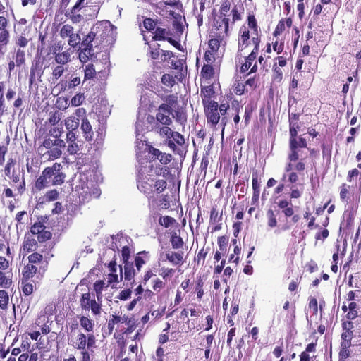
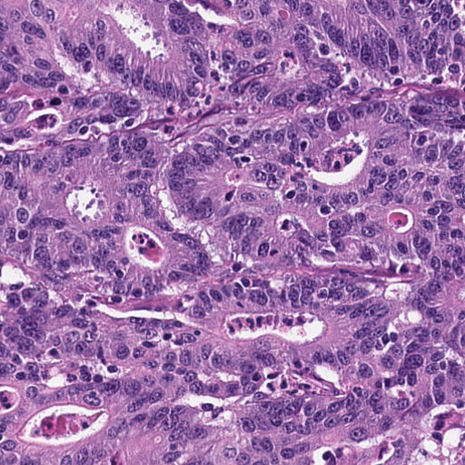
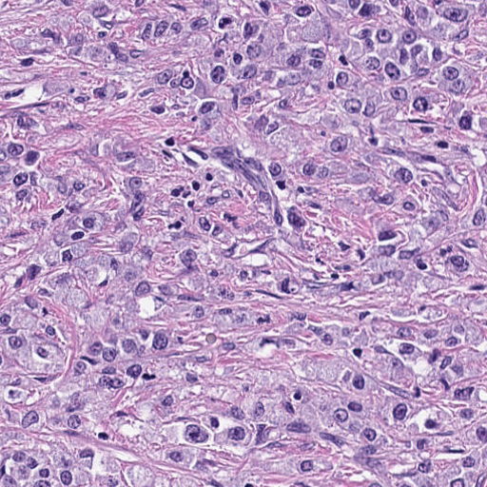
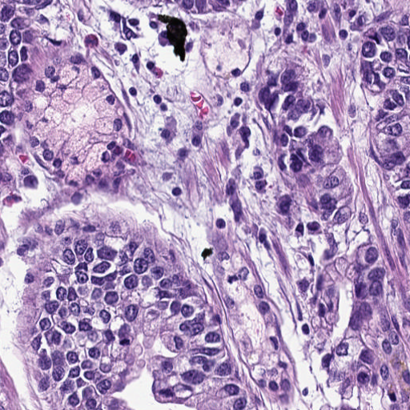
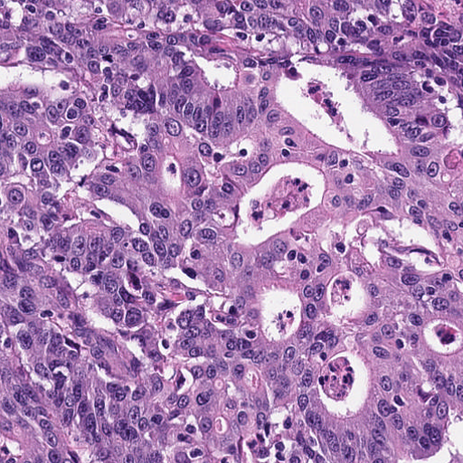
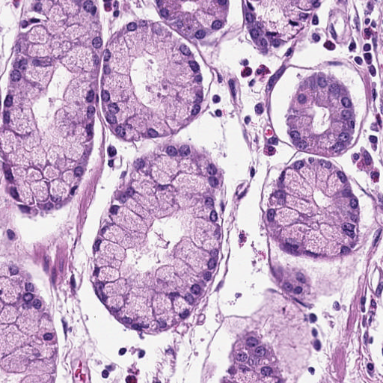
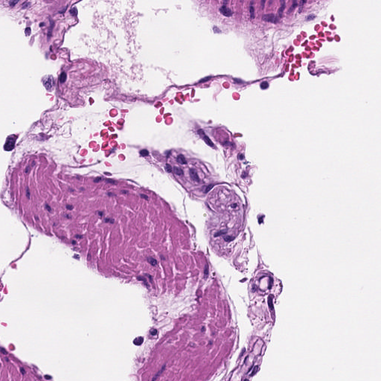
a. Image preprocessing
b. Classified adenocarcinoma epithelium patches
c. KRAS gene mutation prediction
TCGA WSI with KRAS mutation label
TCGA tumor patches
NCT training dataset with tissue type label
NCT testing dataset with tissue type label
Training
Testing
Prediction model
KRAS mutation
or
KRAS wildtype
Classification model
Trained model inference
TCGA patches without tissue type label

Slide 4
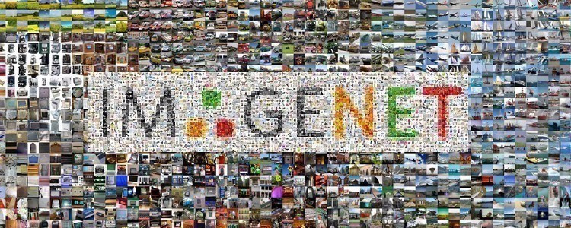
About feature extractor
Pretrained
ResNet-101
https://cv.gluon.ai/build/examples_datasets/imagenet.html
features
……
……
ResNet-101
Can’ t really represent pathological patches
……
……
We need a new way to do feature extraction for classified tumor patches!

Slide 5
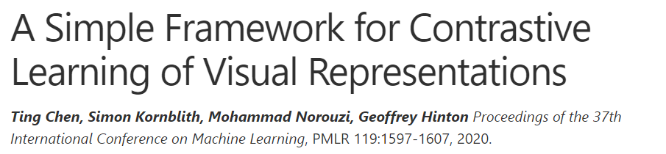
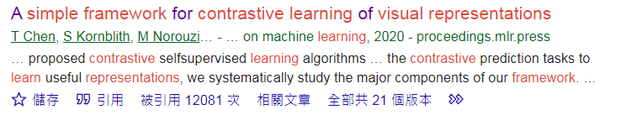
SimCLR: A Simple Framework for Contrastive Learning of Visual Representations

Slide 6
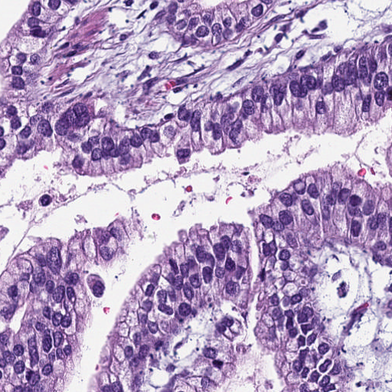
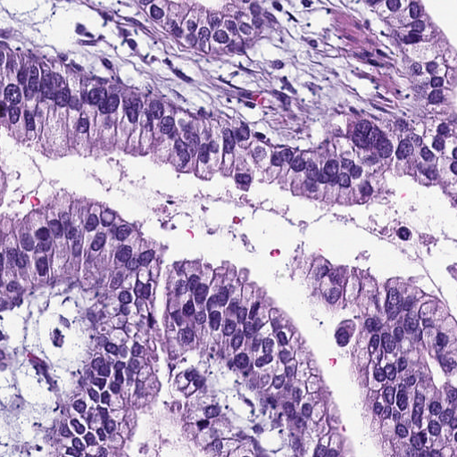
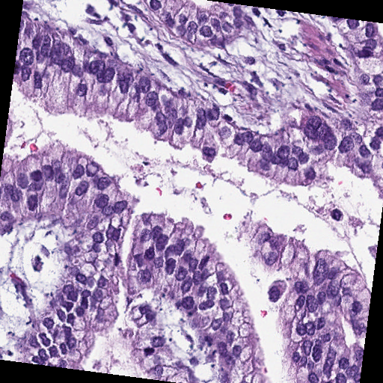
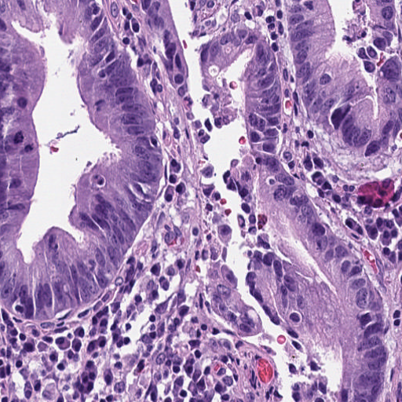
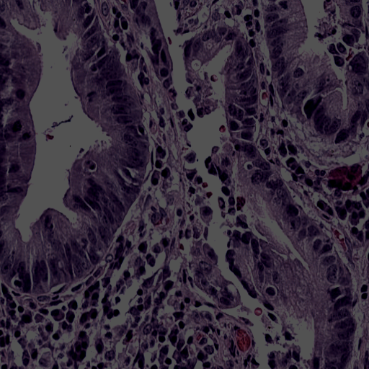
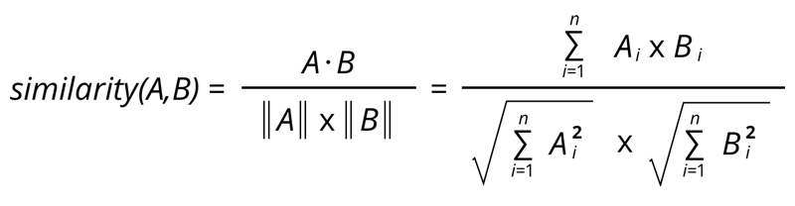
SimCLR: A Simple Framework for Contrastive Learning of Visual Representations
Data augmentation
Embeddings
Encoder
……
Attract
Evaluation metrics
Cosine similarity
Pic.1
Encoder
……
Repel
Encoder
……
Pic.2
SimCLR employs a contrastive learning approach, where it aims to maximize the similarity between positive pairs while minimizing the similarity between negative pairs.

Slide 7
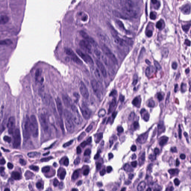
Data augmentation
Representation
Embedding
ResNet-50
……
MLP
……
Maximize
similarity
Pic.1
ResNet-50
……
MLP
……
Minimize
similarity
ResNet-50
……
MLP
……
Maximize
similarity
Pic.2
ResNet-50
……
MLP
……

Slide 8
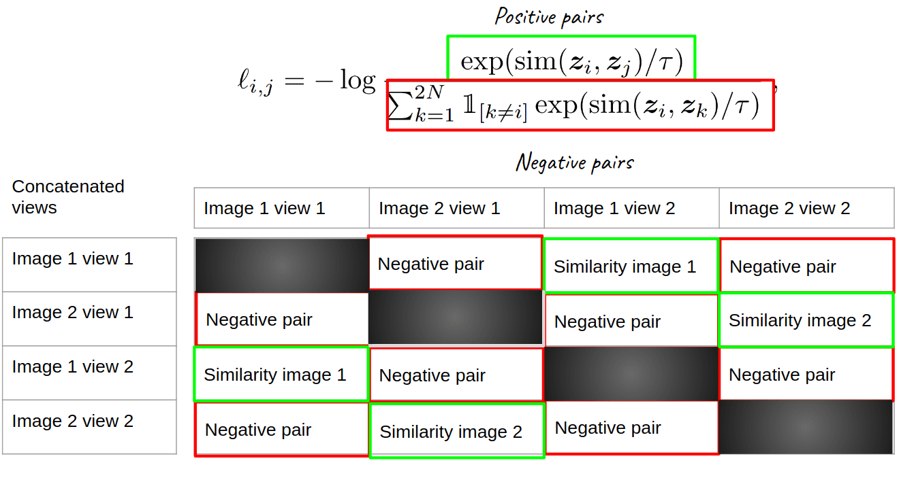
SimCLR loss function formula

Slide 9
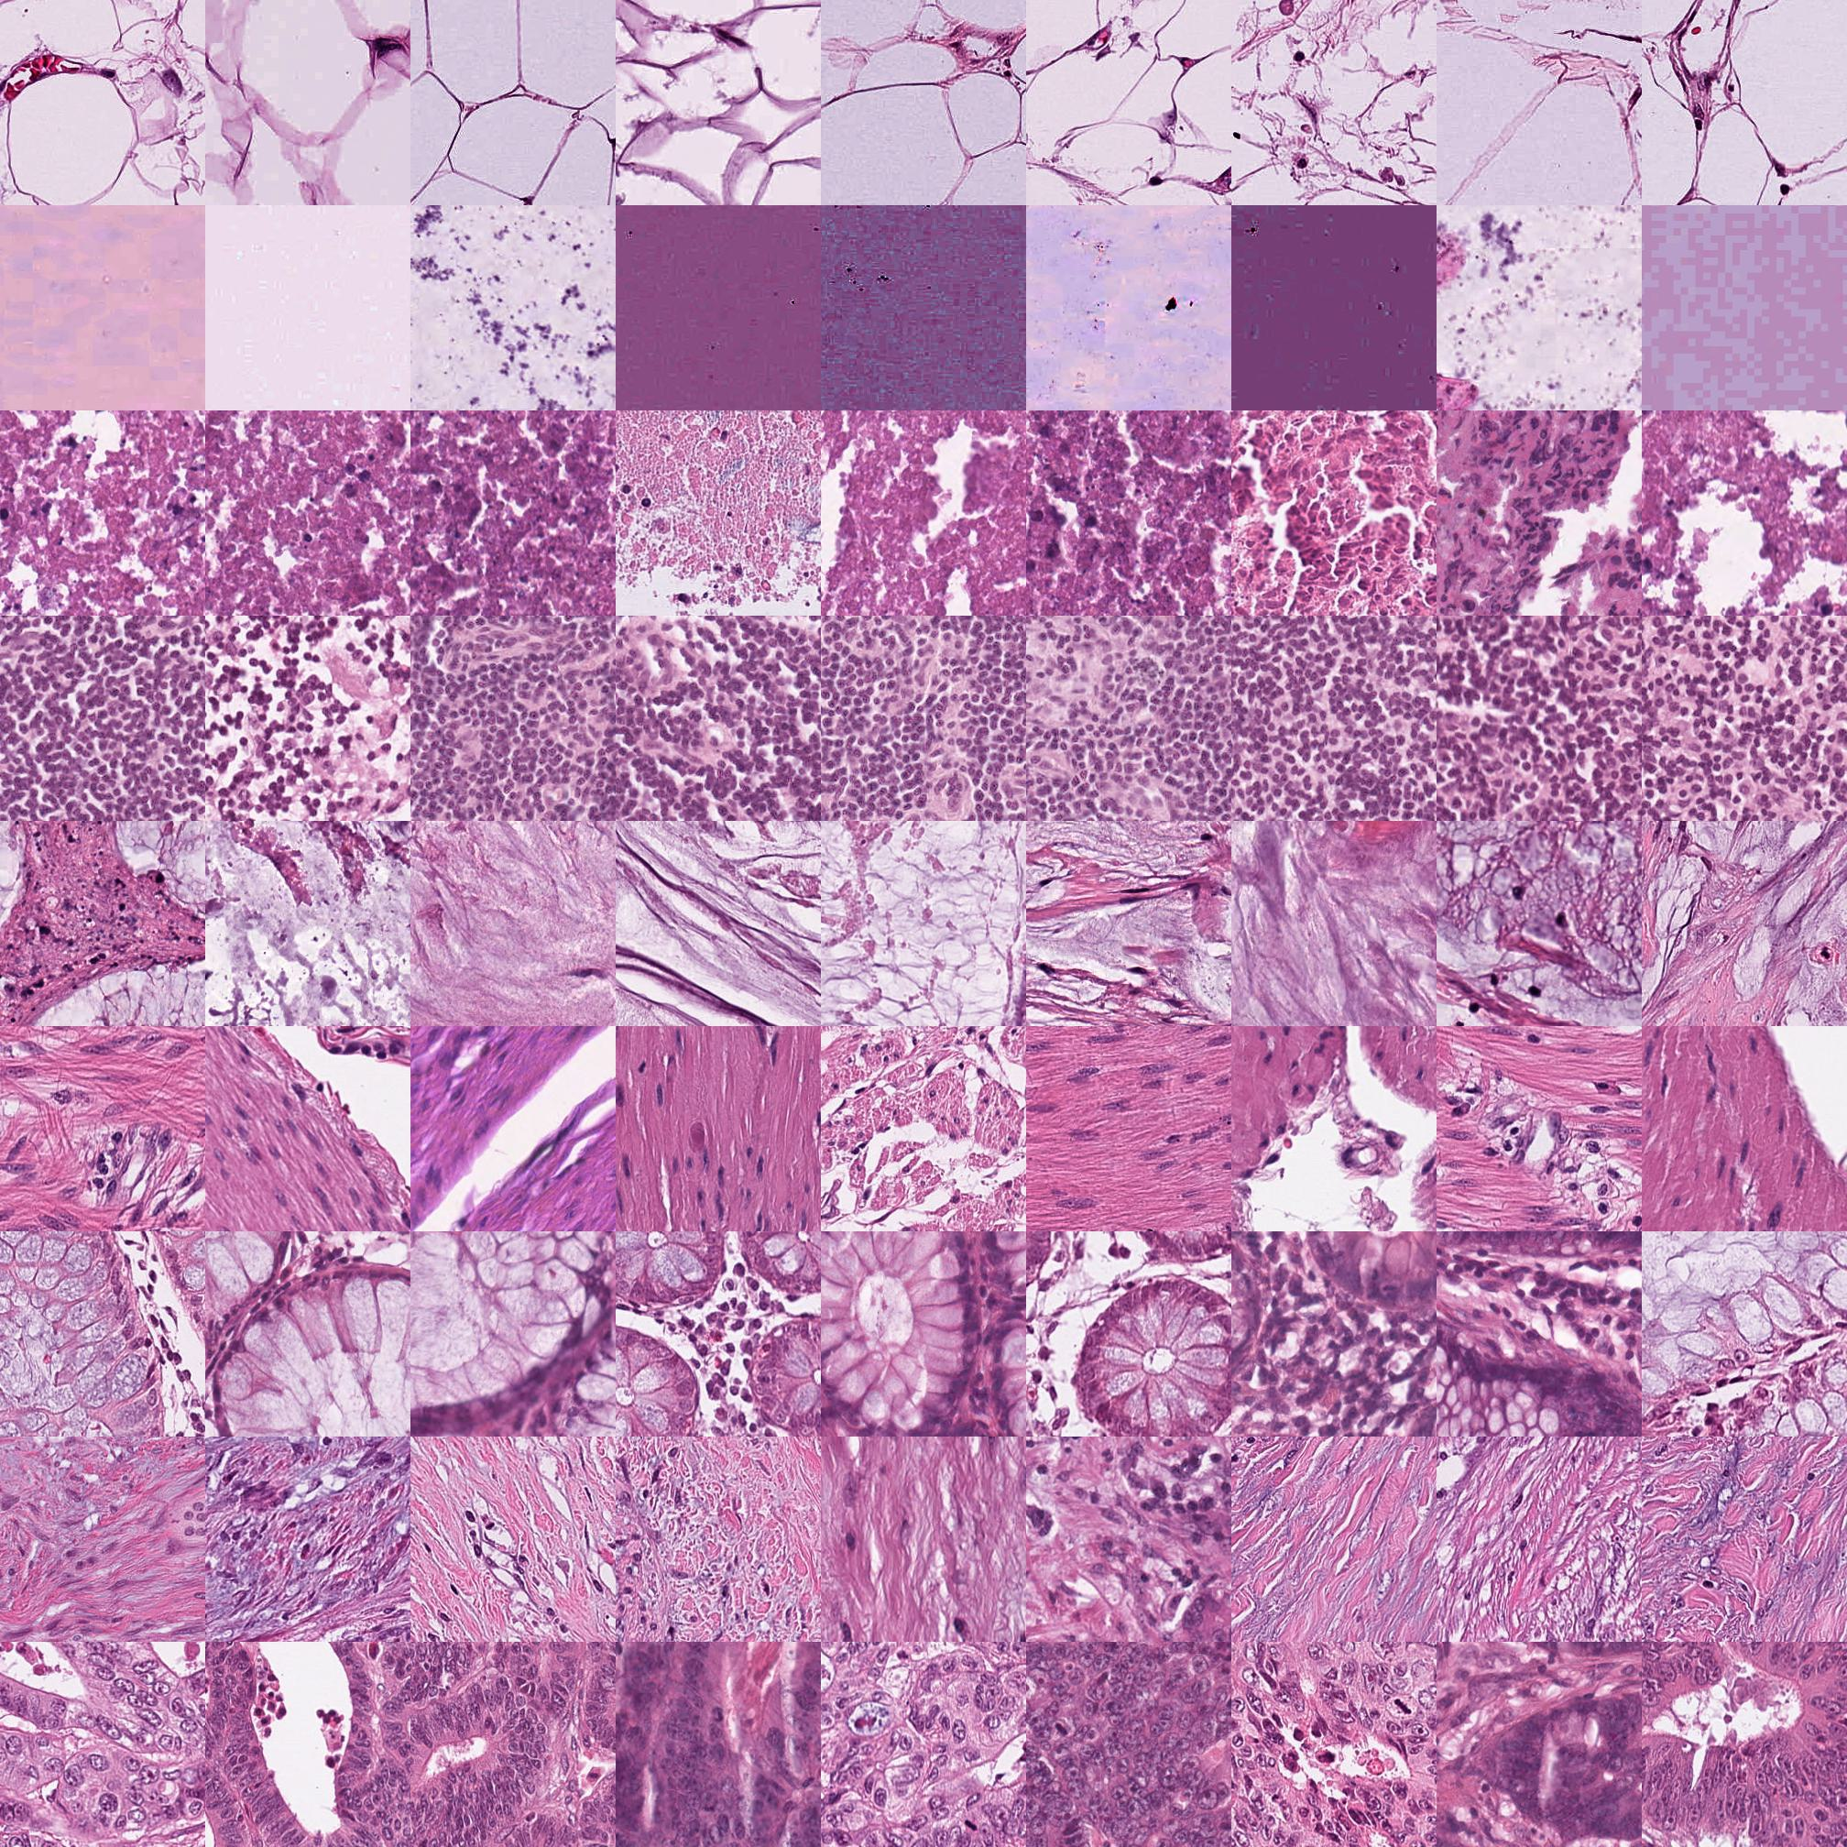
SimCLR training dataset
NCT Biobank (National Center for Tumor Diseases, Heidelberg, Germany)
ADI
BACK
It contains 100,000 histological image patches derived from 86 whole-slide images in 9 classes.
DEB
Tissue classes are:
Adipose (ADI)
Background (BACK)
Debris (DEB)
Lymphocytes (LYM)
Mucus (MUC)
Smooth muscle (MUS)
Normal colon mucosa (NORM)
Cancer-associated stroma (STR)
Colorectal adenocarcinoma epithelium (TUM)
LYM
MUC
MUS
NORM
STR
All images are 224 x 224 pixels at 0.5 microns per pixel (MPP). Also, color-normalized using Macenko's method.
TUM

Slide 10
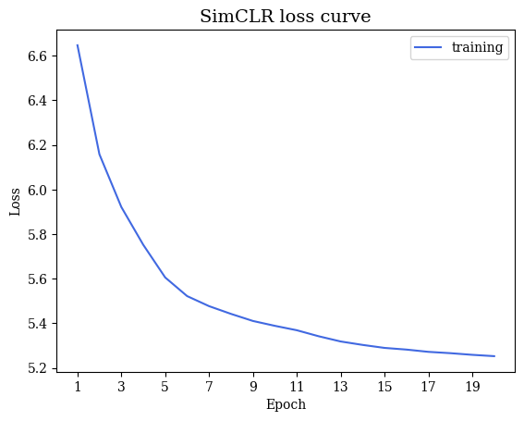
SimCLR training loss curve
Encoder: ResNet50
Projection: nonlinear MLP
Batch size = 500, epoch = 20, learning rate = 0.5, weight decay = 1e-4
Optimizer that I use is adamW also with linear warmup and cosine annealing after 10 epoch
nn.DataParallel was used to utilize multiple GPUs

Slide 11

Future work
1
Finish SimCLR model training with more epochs
2
Use ensemble learning to aggregate multiple classifiers results
3
Develop attention-based model for KRAS gene mutation prediction

Slide 12
c. KRAS gene mutation prediction – SVM (patch level)
c1. Feature extraction for each tumor patches from every WSI and random select 1% of downstream analysis
TCGA classified tumor patches
2048 dim
2048 dim
……
……
Random select 1% of tumor patch from each WSI
……
ResNet-101 model
……
……
n
0.01*n
Feature extractor
……
……
……
……
n
c2. Mix all the selected tumor patch and use the SVM model to give the prediction, where N is slides number
2048 dim
……
……
Support Vector Machine
Patch level prediction
0.01*n*N
……
……

Slide 13
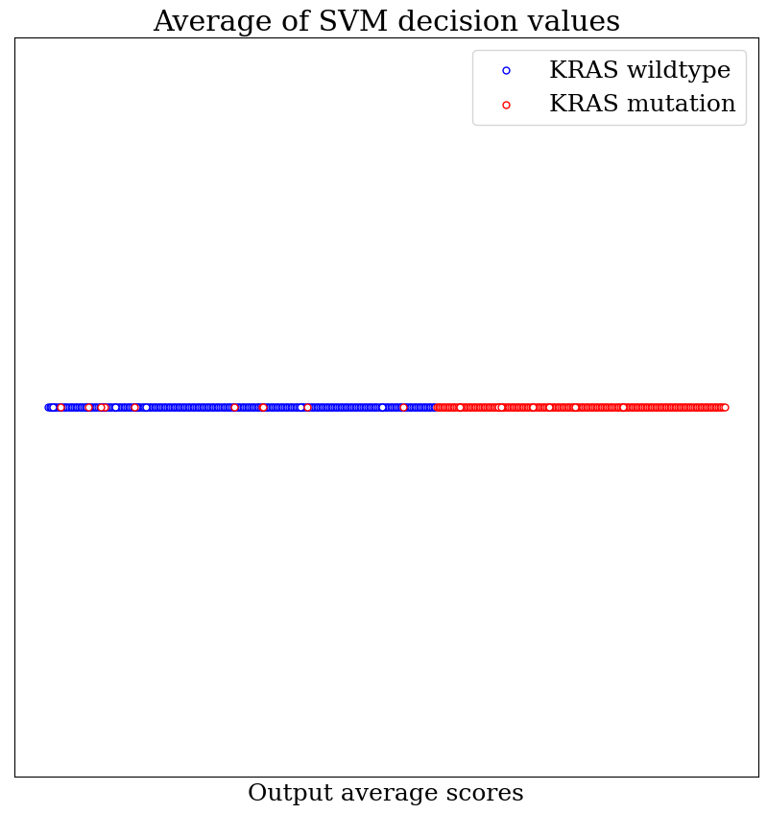
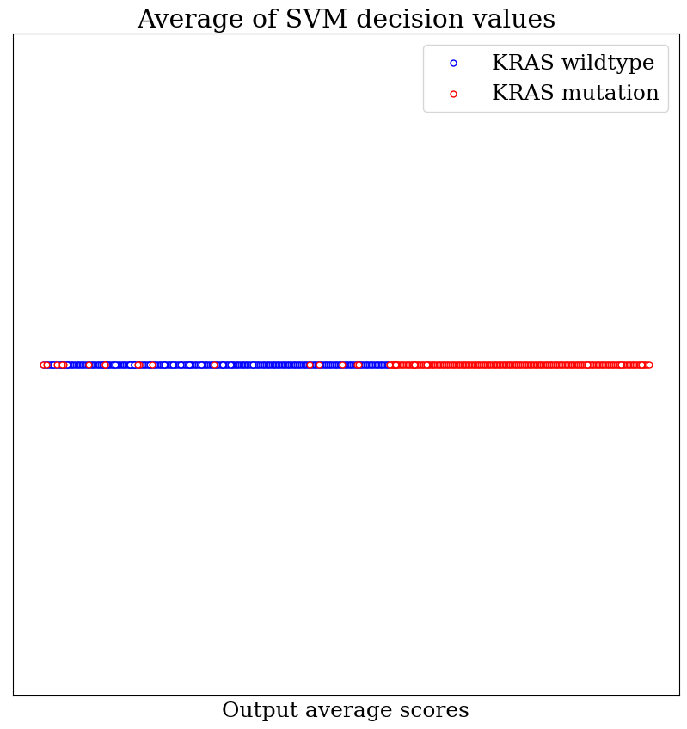
SVM slide-level prediction result
Testing
Training

Slide 14
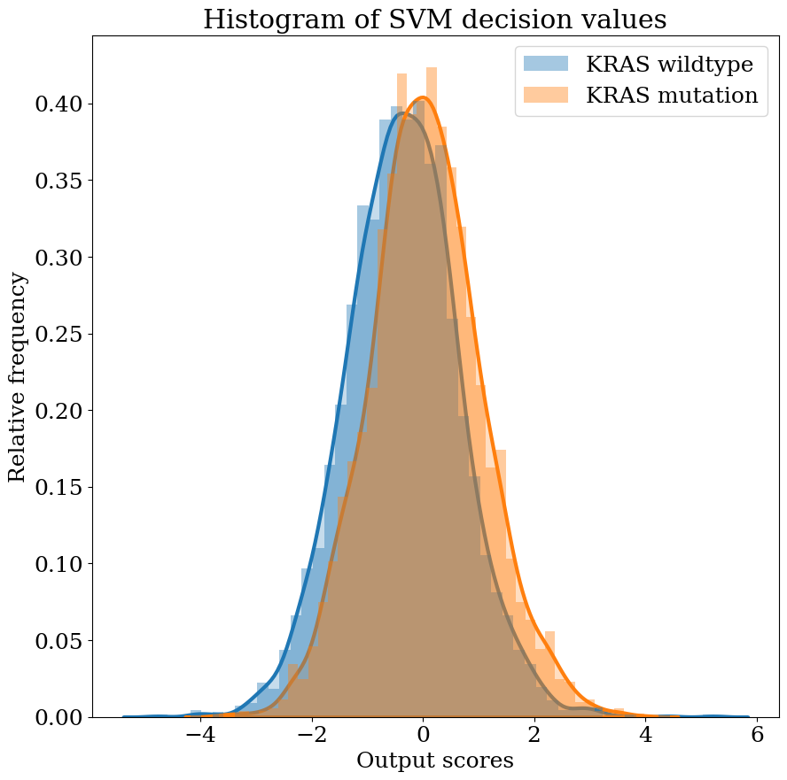
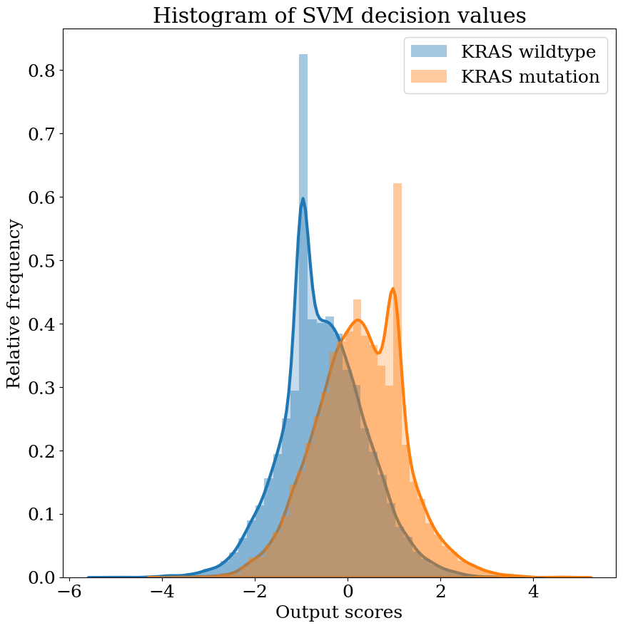
SVM patch-level prediction result
We split the slide-level dataset into training and testing set in the ratio of 8:2
Testing
Training

Slide 15
SVM slide-level prediction result
 | Accuracy | Precision | Recall | AUC
Testing results

